Slide 1
Capstone Project - Car Accident severity
Seemant Arora

Slide 2
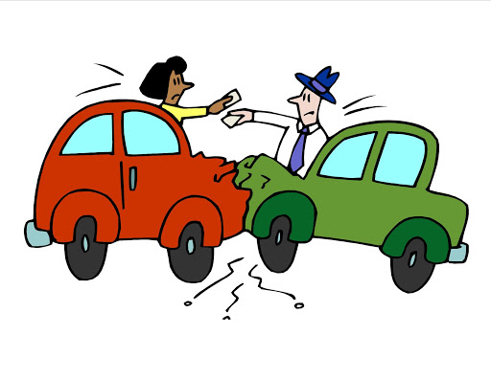
Introduction: Business Problem
Generally road accidents are creating Sevier injuries to people, vehicles or both.
Purpose of this analysis is to build a model to predict the severity of an accident given the Weather and the Road conditions.

Slide 3
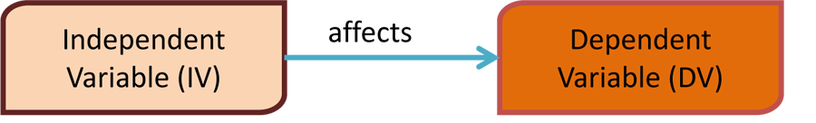
Data Understanding
The time for this data starts from 2004 and consist 194,673 observations and 38 variables
COLLISIONTYPE: Collision type
WEATHER: Weather conditions
ROADCOND: The condition of the road
LIGHTCOND: The light conditions
UNDERINFL: Influence of drugs or alcohol
SEVERITYCODE

Slide 4
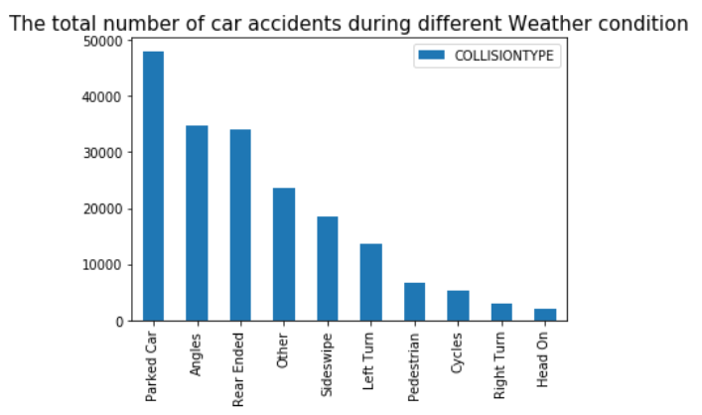
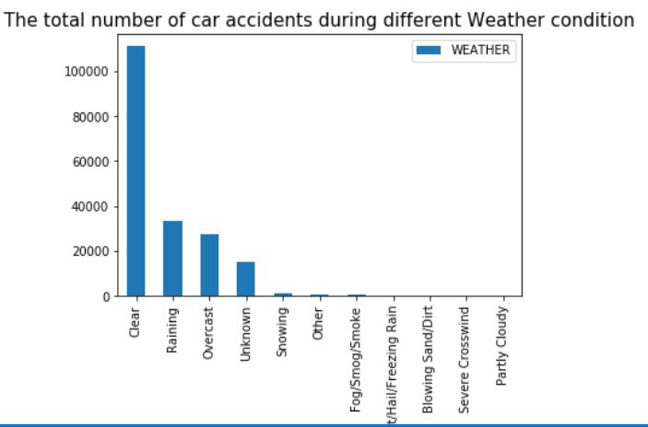
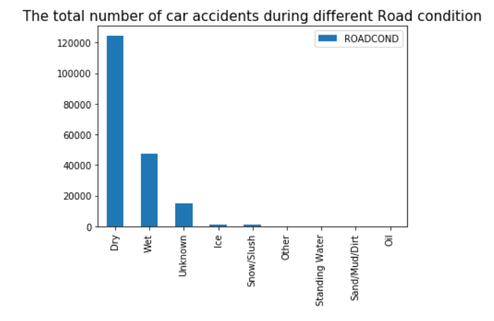
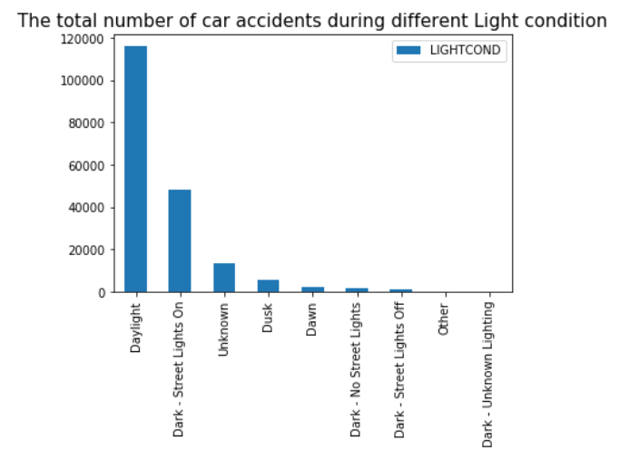
Data Visualisation
Influence of Independent variables on Car Accidents

Slide 5

Data Analysis
1: Data preparation and cleaning
2: Converting the Categorical variables in Numeric Value
3: Normalize Data
4: Split the Data set in to Train and Test set
5: Classification Modeling and Evaluation
5.1 KNN
5.2 logistic Regression
5.3 Decision Tree

Slide 6
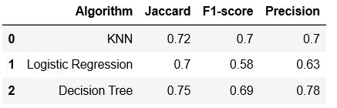
Discussion and Conclusion
In this exercise we evaluated 3 machine learning algorithms to predict the severity of an accident knowing the weather and road conditions. The three models performed very similar, but Decision Tree stood out after comparison of model's accuracy.

